Slide 1
Changes to expect with SOMAH
Name Title

Slide 2
Presenters
John Doe TITLE
Jane Doe
TITLE

Slide 3
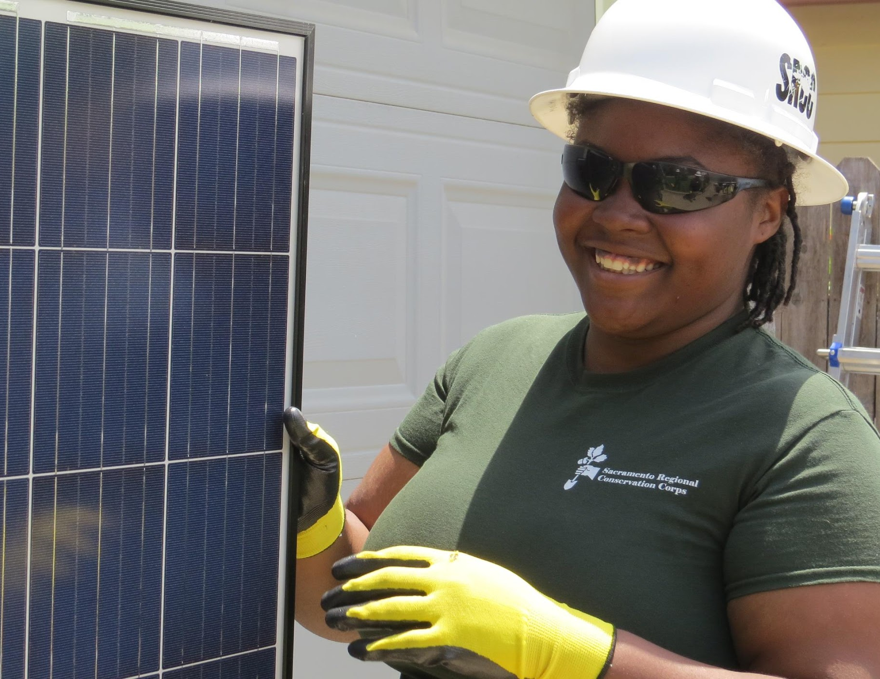
Workshop agenda
VNEM & utility bill
Energy saving tips
Handouts

Slide 4
Virtual net energy metering (VNEM)

Slide 5
VNEM
The electricity created by the solar panels on your building.

Slide 6
VNEM
The electricity is sent to the electric grid and measured by the solar meter.
The electric grid is the network that is run by your utility company that delivers electricity to homes, businesses and other users.

Slide 7
VNEM
The electricity your household uses is measured by your electric meter.

Slide 8
VNEM
Your utility company will add the solar credits allocated to your household, lowering your
monthly bill.

Slide 9
Understanding your utility bill
Tiered rate

Slide 10
Tiered rate structure
Your bill is calculated by different tiers or levels.
Each tier has a specific number of units of electricity.
As you move up tiers you pay more.
For more information contact your utility company

Slide 11
Energy-saving tips
Stay cool in the summer. Set your thermostat at 78°F or higher.
Stay warm in the winter. Set your thermostat at 68°F or lower and wear a cozy sweater. Close the drapes or blinds at night to insulate from the cold.
Take advantage of natural sunlight. Open your blinds or curtains to light and heat your rooms.

Slide 12
Energy-saving tips
Replace all your lightbulbs with long-lasting
light-emitting diode (LED) bulbs.
Take shorter showers. Play a three-minute song while showering to help.
Increase your refrigerator temperature. Set your refrigerator between 36°F and 40°F and freezer to 5°F.

Slide 13
Energy-saving tips
Use the dishwasher for full loads. Use the cool-dry cycle or turn it off after the final rinse and let dishes air dry.
Turn off your lights when leaving a room, even if it’s only for a few minutes.
Unplug appliances. Power strips make it easier to turn them all off at once.

Slide 14
Handouts
How will your utility bill change?
Simple ways to save on energy

Slide 15
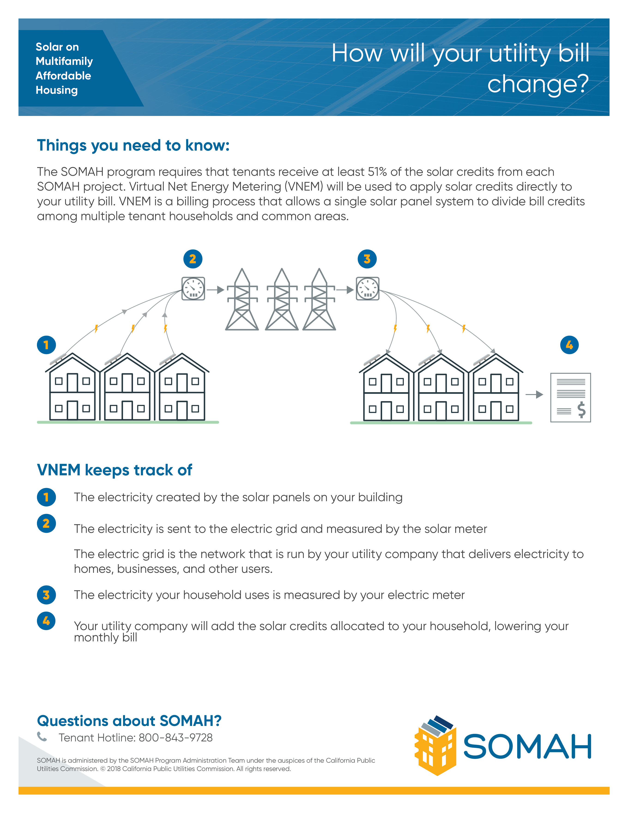
Handouts
How will your utility bill change?

Slide 16
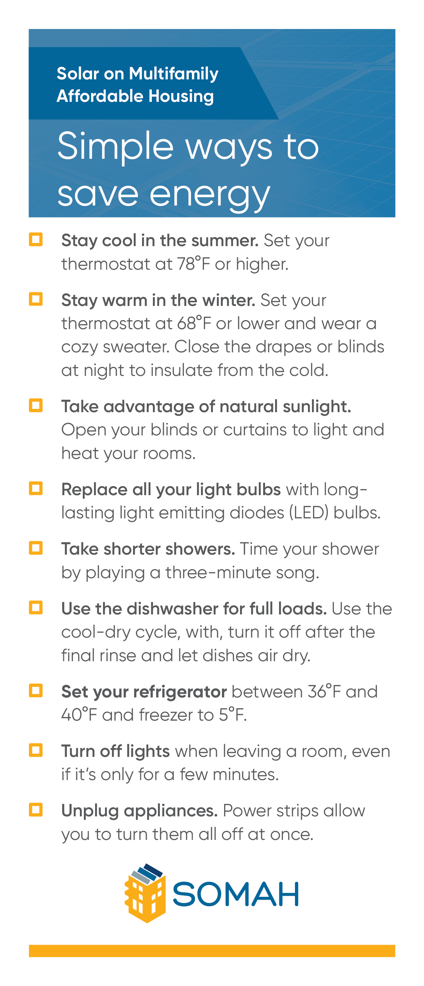
Handouts
Simple ways to save on energy

Slide 17
Questions? Tenant hotline: 800-843-9728 Comments: calsomah.org/contact-us

Slide 18
Thank you for joining.

